Slide 1
Formatting your report
How to get a few extra marks with a little extra effort, and learn good skills at the same time

Slide 2
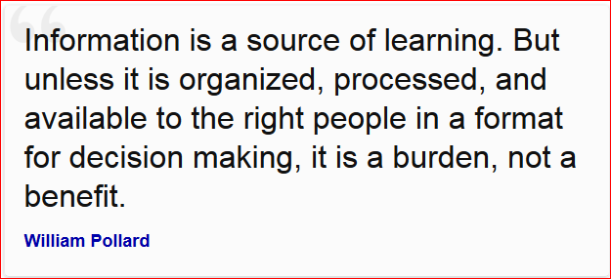
Pollard, C. William (2000), The Soul of the Firm, Zondervan, Grand Rapids, p.123

Slide 3
Some basic issues
Learn to use your chosen Wordprocessor properly
Focus on quality, not quantity
Write in your own words starting on a blank page
Learn to reference, not copy and paste
Assume the audience will have technical knowledge of the subject, and build on that
Focus on what you have achieved in your work

Slide 4
Text
Font
Must be a serif font
Recommend: Times New Roman 12 point
Paragraphs
1.5 line spacing
Left justification
Use a line space between paragraphs
Page headers
Include title and page numbers
DO NOT use a decorative template

Slide 5

Headings
Use styles to format the headings as level 1, level 2, level 3, etc.
Crucial for automatic generation of a Table of Contents page
Makes modification of a heading style easy
Set up the outline numbering to automatically number your headings

Slide 6
Write in the passive voice
It is understood that all actions are done by the author
Examples
“This report describes the development of a prototype …”
“A prototype was developed …”
NOT “The author developed this prototype…”

Slide 7
Write in the third person
Reports demonstrate facts that do not depend on the observer, so should avoid using the first and second person (I, me, my, we, our OR us)
"The colours that were chosen were from a set of standards agreed by .. "
NOT “I thought the colours were a good choice”
First person is acceptable, but not necessary, in evaluative parts
“In hindsight, I wish I had listened to my lecturer”

Slide 8
Images
Grabbing
Use the Snipping Tool
Formatting
Cropping
Remove the surrounding browser image
But include the URL
Resizing
Improve the aesthetics
Reducing file size
Without losing image quality
Captioning
With automatic numbering
For cross-referencing (as in Figure 3…)
All images must be referenced in the text

Slide 9
The Title Page
“You never get a second chance to make a first impression” (Anon.)
No spelling mistakes
Word count
must be accurate
exclude Preliminaries and Appendices

Slide 10
Table of Contents
Use built-in facility of your wordprocessor
Check for errors
Ensure section names are short and appropriate
Make sure you update the ToC if you edit the document
Include a separate Table of Illustrations if appropriate

Slide 11
Referencing
Understand why referencing is important
Use Harvard Referencing
Excellent video
University Moodle Course
University Guide
Identify the surname (family name) of authors
Identify authors and dates for web pages
Give primary sources if possible
NOT Wikipedia
Know the difference between a reference and a bibliography

Slide 12
References
A reference list contains only those sources you actually referred to (cited) in your work
For each reference on your list there will be some citation in your work
References can be listed in the order in which they appear (in which case they are numbered 1, 2, 3, etc.) or an author [date] system can be used
References are specific (eg to a specific page or web URL) so page numbers are expected

Slide 13
Bibliographies
A bibliography is a list of all relevant sources you consulted
This list contains all those books, articles, website, etc. you cite in your work but also those ones you consulted but didn't actually cite
Bibliography entries can be quite general (e.g. a whole book or website) or specific (e.g. a chapter in a book)
Bibliographies must be in alphabetical order by surname

Slide 14
Help with Referencing
Using MS Word
Use Harvard (Anglia) style
Watch this excellent video
Problems
Identifying the surname
Christine du Toit
du Toit, Christine
Multiple authors (more than 2)
Stoneham, R., Kiernan, M. et al.

Slide 15
Reference Management Software
EndNote
MyEndNoteWeb
Cite This For Me
Mendeley
Qiqqa
Zotero

Slide 16
Appendices
Contain supporting documentation referenced in the main body of the report
Labelled Appendix A, B, C, etc.
Appendices must always be after everything else in the report
Appendices must be after the Bibliography
You do not necessarily need appendices
But if you have them you must cross-reference them all somewhere in the text

Slide 17
Some tips
DO NOT SHOUT
Avoid using underline – it is ugly
Check your speling
Check you’re grammar
Don’t abbrev.
Check to see if you any words out
BTW do not use terms like GR8, IMHO or BTW
Do not use a long sentence when you can say the same thing in a short sentence and be much more effective.
Last but not least, lay off cliches

Slide 18
Summary
Learn to wordprocess properly
Understand why referencing and cross referencing are important
Avoid “Copy and Paste”
Be consistent
Pay “attention to detail”
Make it look professional

